Slide 1
SCIENTIFIC COMPUTING Data Analysis
SEBASTIÁN ROLDÁN VASCO, MSc., PhD.
sebastianroldan@itm.edu.co

Slide 2
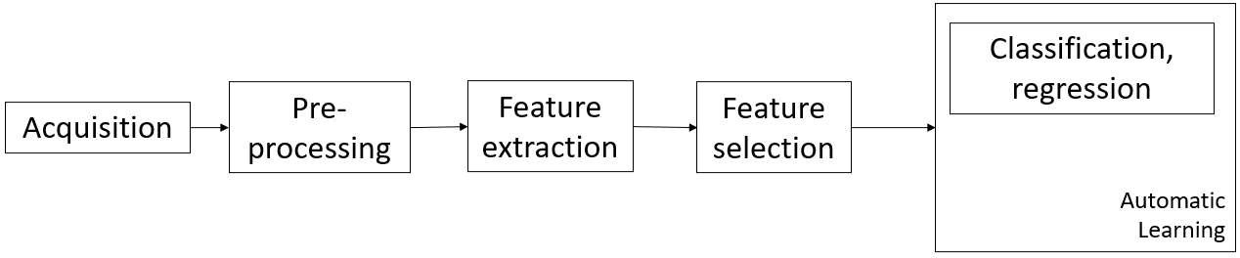
Pattern recognition postulates*
Pattern recognition → automatic detection of patterns in sensed data
Sample set
Features
Compactness
Decomposition
Structure
Similarity
Based on the lecture of Pattern Recognition by Dr.-Ing. Juan Rafael Orozco Arroyave

Slide 3
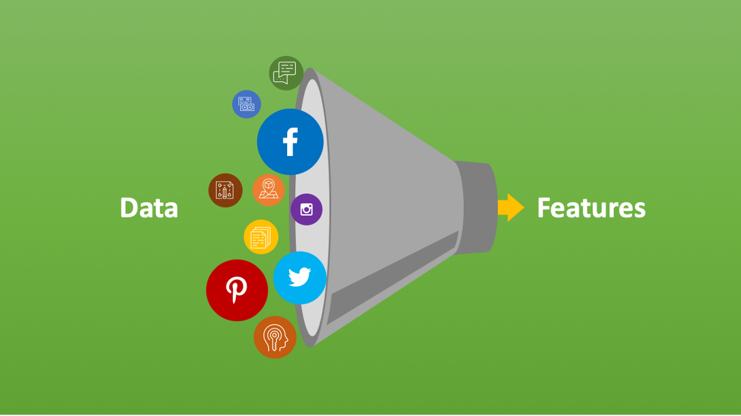
Feature (data) space
https://www.analyticsvidhya.com/blog/2021/04/guide-for-feature-extraction-techniques/

Slide 4
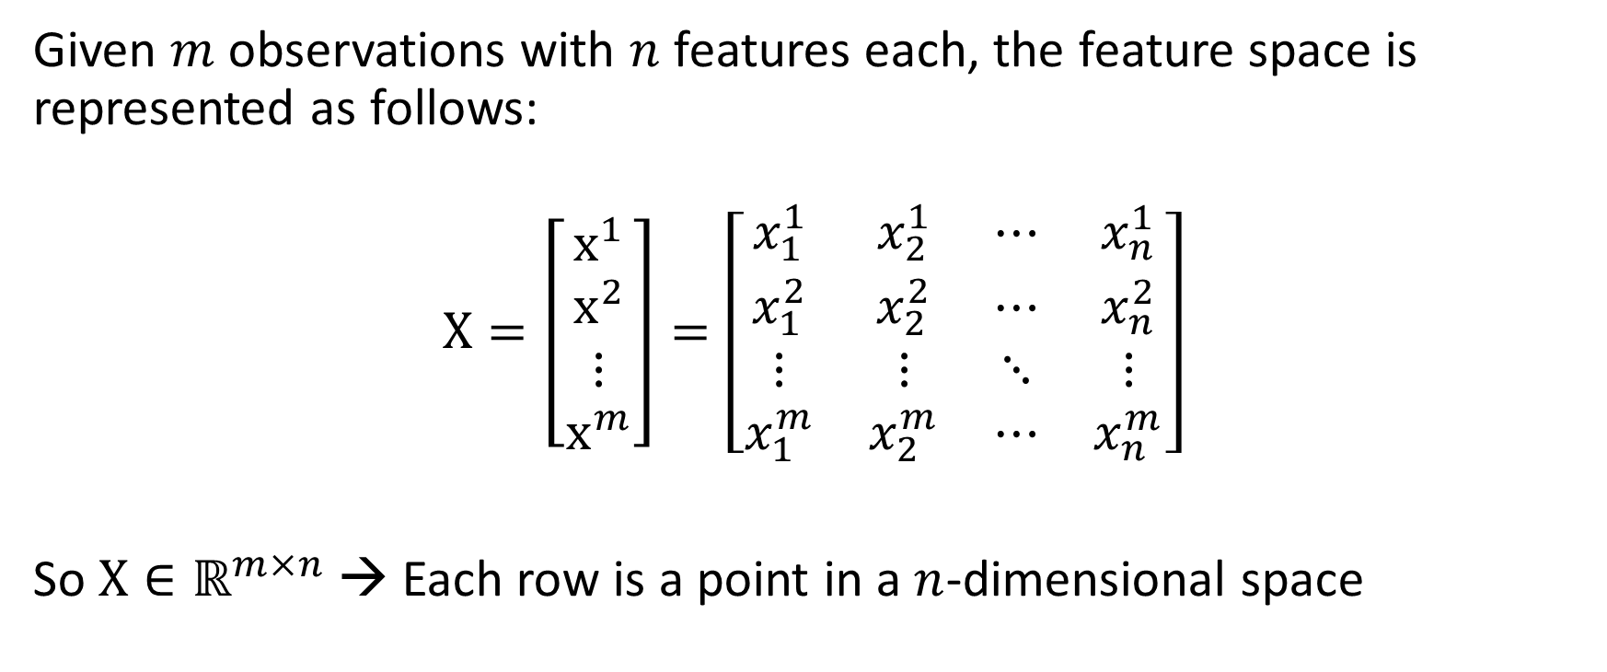
Feature (data) space
Given $m$ observations with $n$ features each, the feature space is represented as follows:
$$X=\left[\begin{matrix}x^{1} \\ x^{2} \\ ⋮ \\ x^{m}\end{matrix}\right]=\left[\begin{matrix}x_{1}^{1} & x_{2}^{1} & ⋯ & x_{n}^{1} \\ x_{1}^{2} & x_{2}^{2} & ⋯ & x_{n}^{2} \\ ⋮ & ⋮ & ⋱ & ⋮ \\ x_{1}^{m} & x_{2}^{m} & ⋯ & x_{n}^{m}\end{matrix}\right]$$
So $X∈ℝ^{m×n}$ → Each row is a point in a $n$-dimensional space

Slide 5
Pattern recognition postulates*
https://towardsdatascience.com/feature-extraction-techniques-d619b56e31be

Slide 6
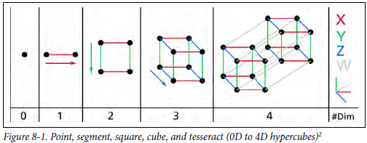
Pattern recognition postulates*
Hands-on Machine Learning with Scikit-Learn, Keras and TensorFlow: Concepts, Tools, and Techniques to Build Intelligent Systems. 2nd ed., O'Reilly, 2019.

Slide 7

Warm-up

Slide 8
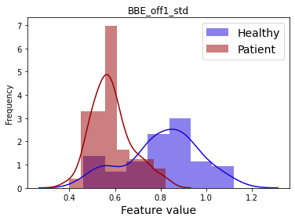
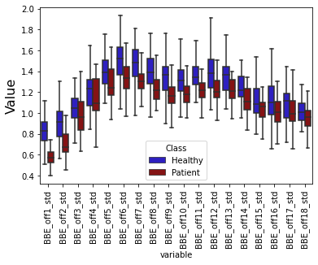
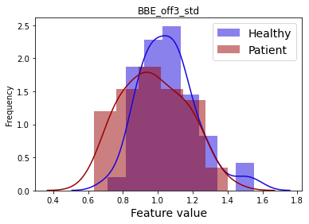
Warm-up

Slide 9
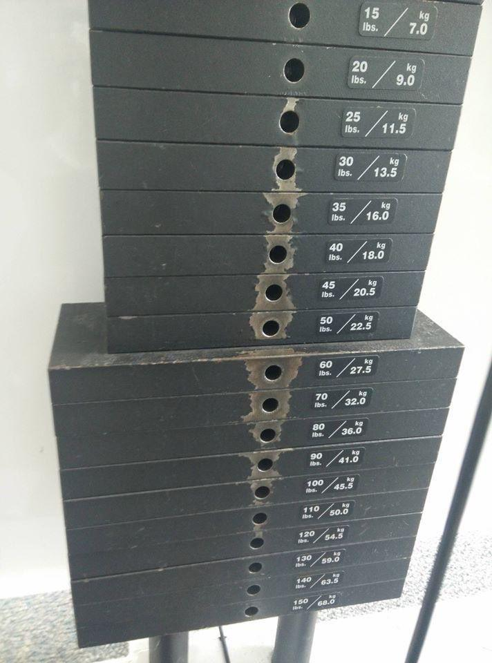
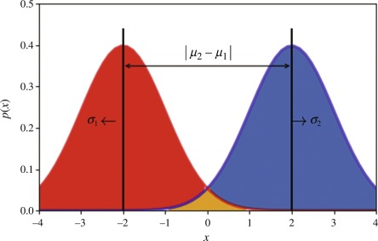
Class separability
It is a measure of the discriminative power of a feature (Zgallai, W. A, 2020)
Two class-conditional densities for two equiprobable classes

Slide 10
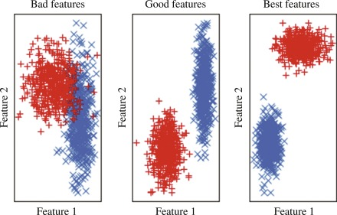
Class separability
Higher separability is obtained with large interclass and small within-class distances (Zgallai, W. A, 2020)
Scatter plots showing class separability of two-dimensional datasets (Zgallai, W. A, 2020)

Slide 11
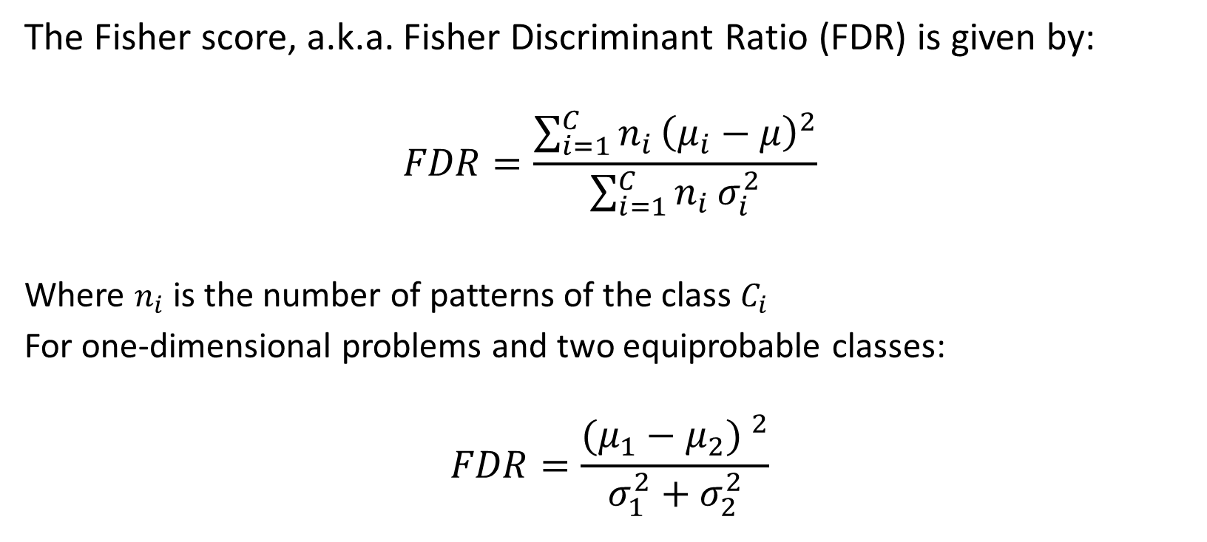
Separability criteria
The Fisher score, a.k.a. Fisher Discriminant Ratio (FDR) is given by:
$$FDR=\frac{\sum_{i=1}^{C}{n_{i}}{\left(μ_{i}−μ\right)}^{2}}{\sum_{i=1}^{C}{n_{i}}σ_{i}^{2}}$$
Where $n_{i}$ is the number of patterns of the class $C_{i}$
For one-dimensional problems and two equiprobable classes:
$$FDR=\frac{{(μ_{1}−μ_{2}) }^{2}}{σ_{1}^{2}+σ_{2}^{2}}$$

Slide 12
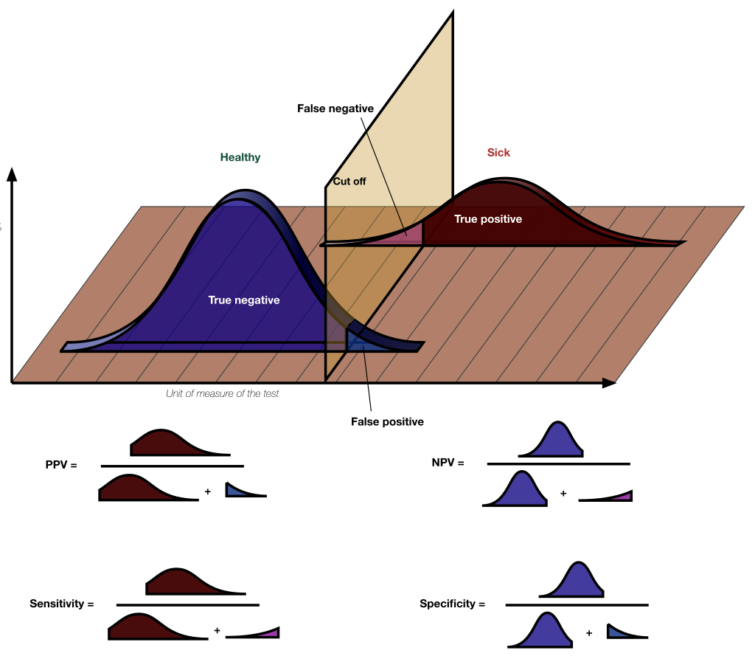
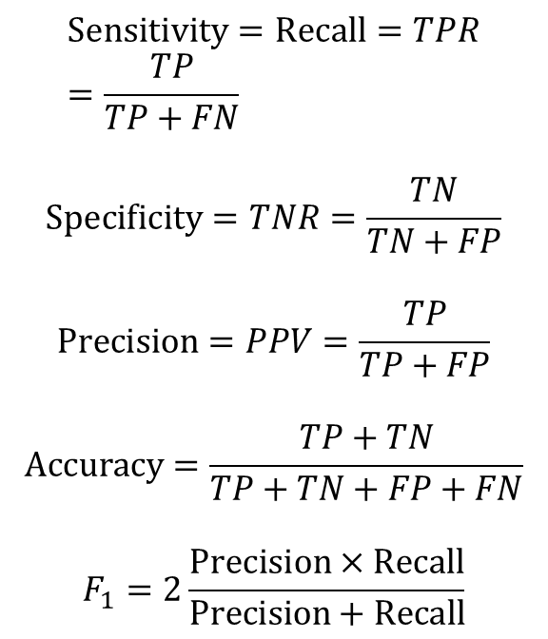
Performance measures
$$Sensitivity=Recall=TPR=\frac{TP}{TP+FN}$$
$$Specificity=TNR=\frac{TN}{TN+FP}$$
$$Precision=PPV=\frac{TP}{TP+FP}$$
$$Accuracy=\frac{TP+TN}{TP+TN+FP+FN}$$
$$F_{1}=2\frac{Precision×Recall}{Precision+Recall}$$
By Original by Luigi Albert Maria - SVG version of File:PPV, NPV, Sensitivity and Specificity.pdf, CC BY-SA 4.0, https://commons.wikimedia.org/w/index.php?curid=99283192

Slide 13
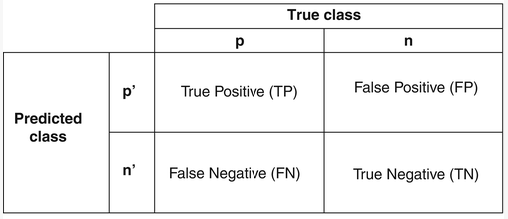
Performance measures
Contigency tables are useful to represent the number of TP, TN, FP and FN
Melo, F. (2013). Receiver operating characteristic (ROC) curve. Springer NY, 67, 1818-1823.

Slide 14
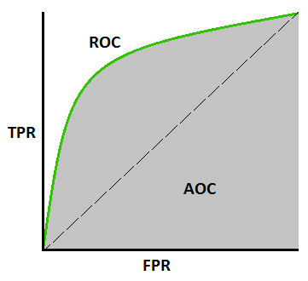
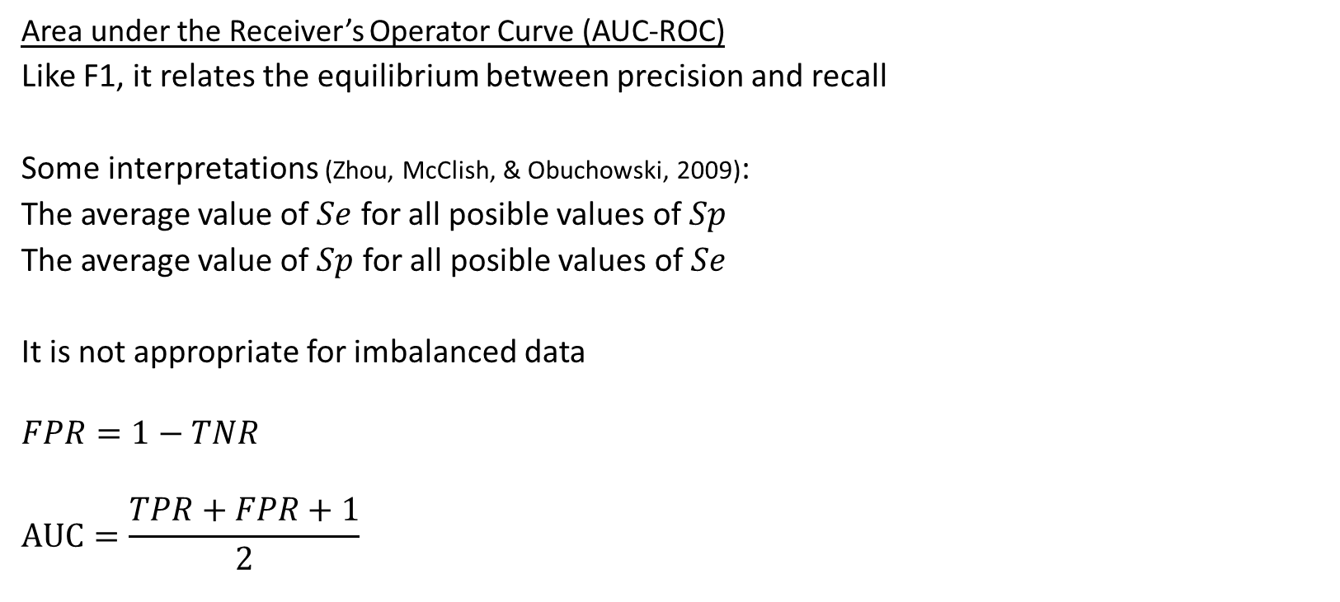
Performance measures
Area under the Receiver’s Operator Curve (AUC-ROC)
Like F1, it relates the equilibrium between precision and recall
Some interpretations (Zhou, McClish, & Obuchowski, 2009):
The average value of $Se$ for all posible values of $Sp$
The average value of $Sp$ for all posible values of $Se$
It is not appropriate for imbalanced data
$$FPR=1−TNR$$
$$AUC=\frac{TPR+FPR+1}{2}$$
https://towardsdatascience.com/understanding-auc-roc-curve-68b2303cc9c5

Slide 15
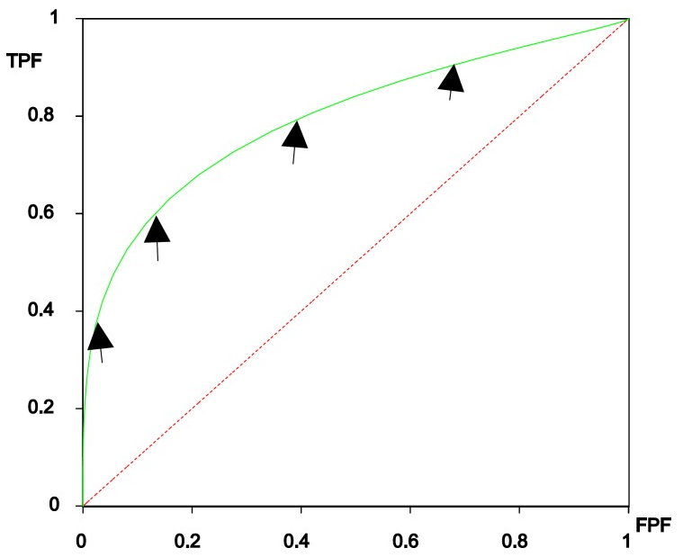
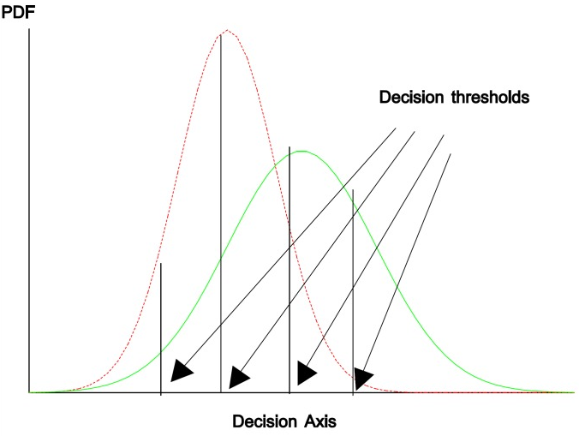
Performance measures
Area under the Receiver’s Operator Curve (AUC-ROC)
Hajian-Tilaki, K. (2013). Receiver operating characteristic (ROC) curve analysis for medical diagnostic test evaluation. Caspian journal of internal medicine, 4(2), 627.

Slide 16
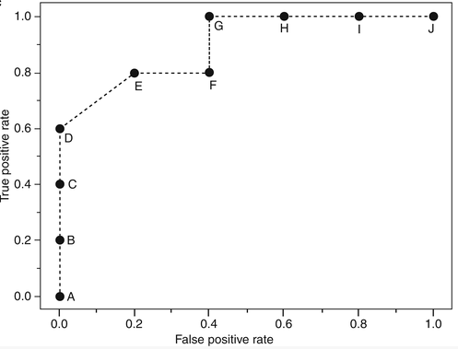
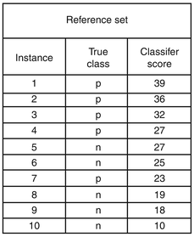
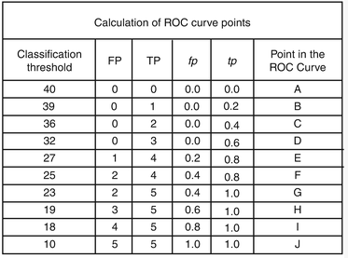
Performance measures
Area under the Receiver’s Operator Curve (AUC-ROC)
Melo, F. (2013). Receiver operating characteristic (ROC) curve. Springer NY, 67, 1818-1823.

Slide 17
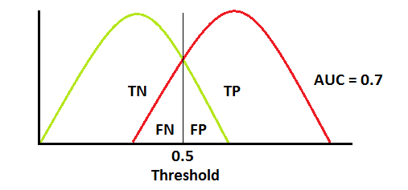
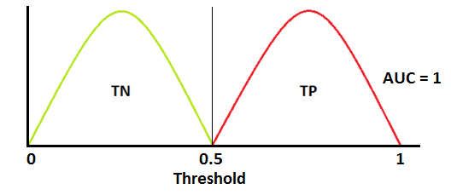
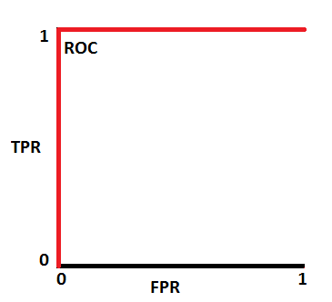
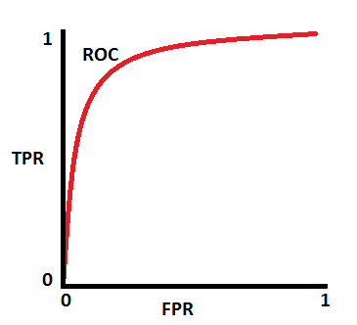
Performance measures
Area under the Receiver’s Operator Curve (AUC-ROC)
https://towardsdatascience.com/understanding-auc-roc-curve-68b2303cc9c5

Slide 18
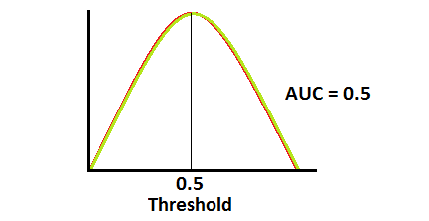
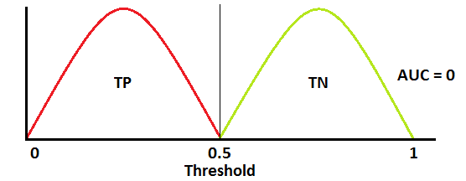
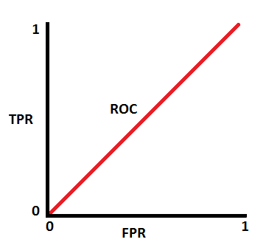
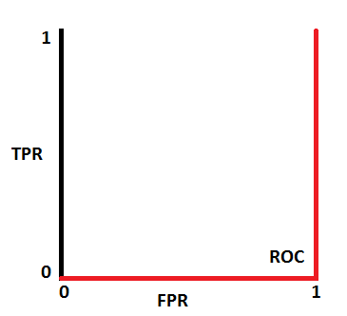
Performance measures
Area under the Receiver’s Operator Curve (AUC-ROC)
https://towardsdatascience.com/understanding-auc-roc-curve-68b2303cc9c5

Slide 19
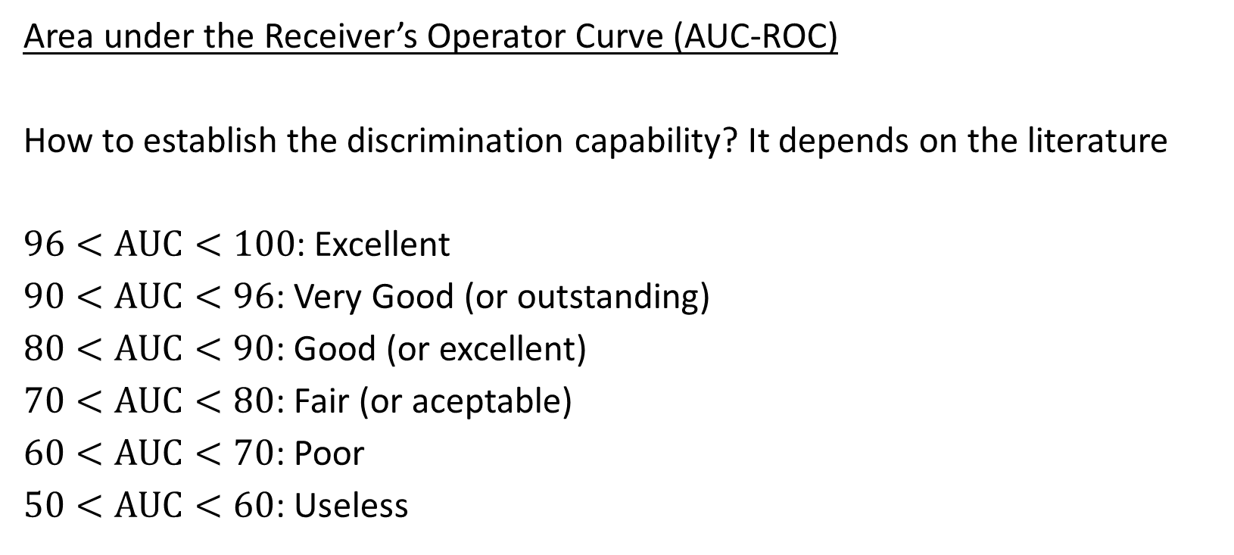
Performance measures
Area under the Receiver’s Operator Curve (AUC-ROC)
How to establish the discrimination capability? It depends on the literature
$96<AUC<100$: Excellent
$90<AUC<96$: Very Good (or outstanding)
$80<AUC<90$: Good (or excellent)
$70<AUC<80$: Fair (or aceptable)
$60<AUC<70$: Poor
$50<AUC<60$: Useless

Slide 20
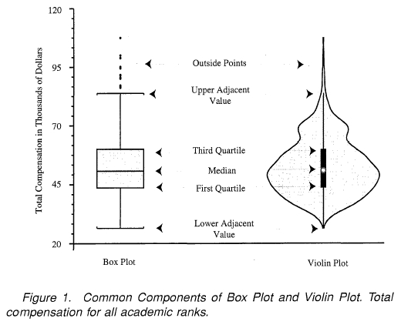
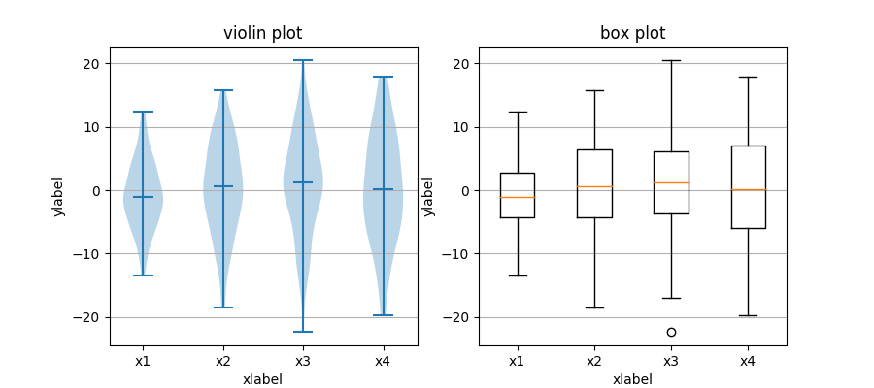
Useful plots for feature analysis
https://matplotlib.org/3.1.1/gallery/statistics/boxplot_vs_violin.html
https://towardsdatascience.com/violin-plots-explained-fb1d115e023d

Slide 21
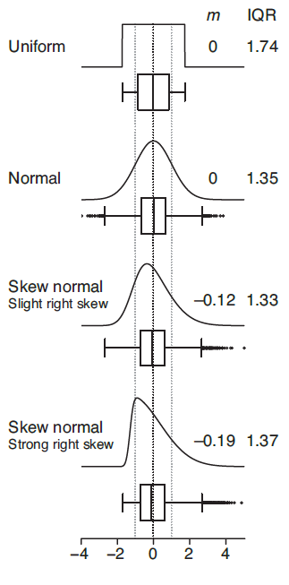
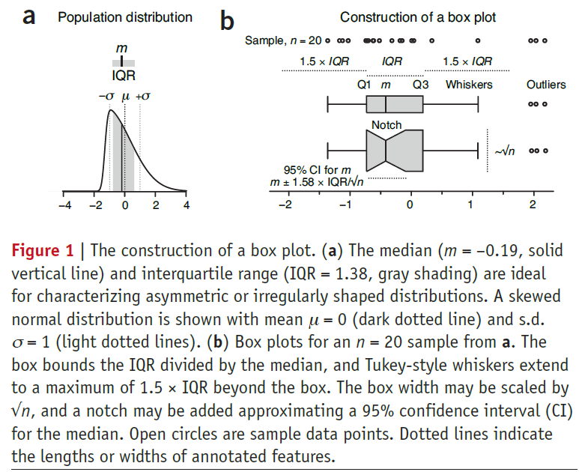
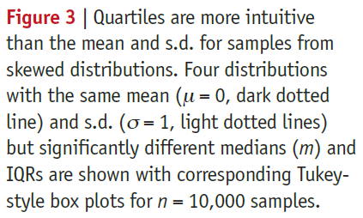
Useful plots for feature analysis
Krzywinski, M., & Altman, N. (2014). Visualizing samples with box plots: use box plots to illustrate the spread and differences of samples. Nature Methods, 11(2), 119-121.

Slide 22
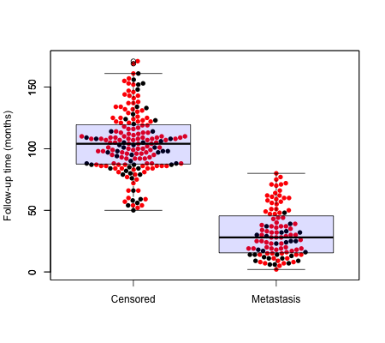
Useful plots for feature analysis
Beeswarm plot

Slide 23
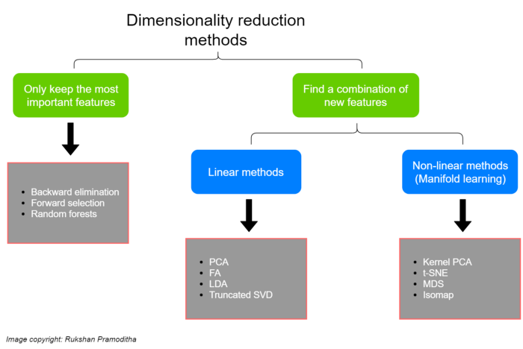
Feature selection
It conserves semantics
https://towardsdatascience.com/11-dimensionality-reduction-techniques-you-should-know-in-2021-dcb9500d388b

Slide 24
Feature selection
Classification according to the objective (Urbanowicz, Meeker, La Cava, Olson, & Moore, 2018):
Idealized:
Minimally sized feature subset necessary and sufficient to describe the target concept
Target feature count:
The size such that the value of a criterion function is optimized over all sizes
Prediction accuracy improvement:
Size that increases the prediction accuracy or decreases model complexity
Approximate original class prediction probability distribution:
Choose a subset that achieves a class prediction probability distribution as close as possible to that given by all features
Rank and define cutoff:
Rank all features using some value, and define an ad-hoc cutoff (statistical, subjective or simply a desired number of features)

Slide 25
Feature selection
HYPOTHESIS TESTS
Hypothesis testing is a statistical method used to make decisions or inferences about a population based on sample data.
It is a fundamental aspect of inferential statistics.

Slide 26
Feature selection
HYPOTHESIS TESTS
Formulate hypothesis:
Null Hypothesis (H₀): No differences between groups
Alternative Hypothesis (H₁ or Ha): It contradicts H₀
2. Select a significance Level (α):
The significance level is the probability of rejecting H₀ when it is actually true (Type I error).
Common choices for α are 0.05, 0.01, or 0.10.

Slide 27
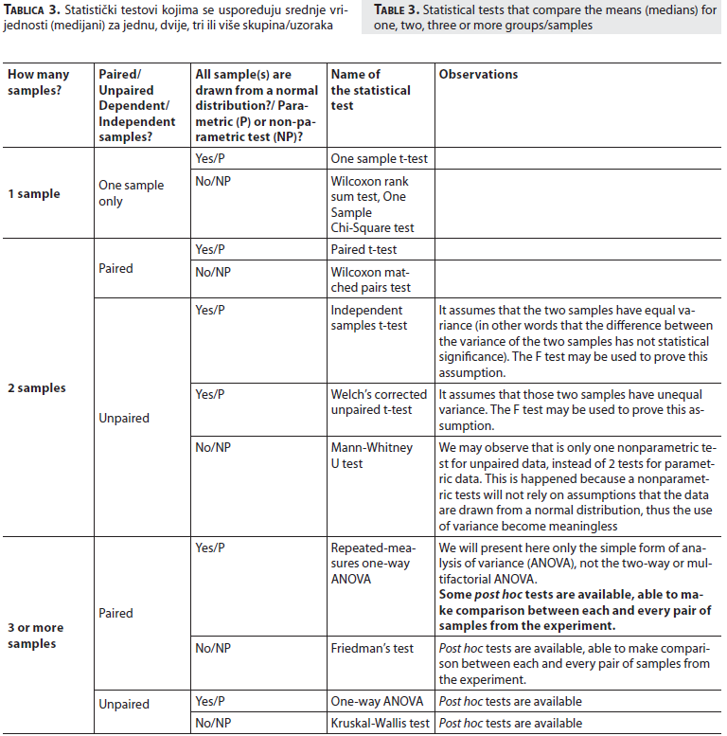
Feature selection
HYPOTHESIS TESTS
3. Choose the appropriate test:
Check data normality:
Shapiro–Wilk test, Kolmogorov–Smirnov test
Select the most appropriate statistical test accordingly
4. Determine the critical value (p-value)
p-value is the probability of obtaining test results at least as extreme as the results actually observed, under the assumption that H₀ is correct.
5. Make a decision
If p-value ≤ α → reject H₀ → significant statistical difference
Marusteri, M., & Bacarea, V. (2010). Comparing groups for statistical differences: how to choose the right statistical test?. Biochemia medica, 20(1), 15-32.

Slide 28
Feature selection
ANOVA
Analysis of Variance is a statistical method used to compare the means of three or more groups to determine if there are statistically significant differences between them.
ANOVA works by partitioning the total variance observed in the data into different sources:
- Between-group variance: Variance between the means of different groups.
- Within-group variance: Variance within each group or category.

Slide 29
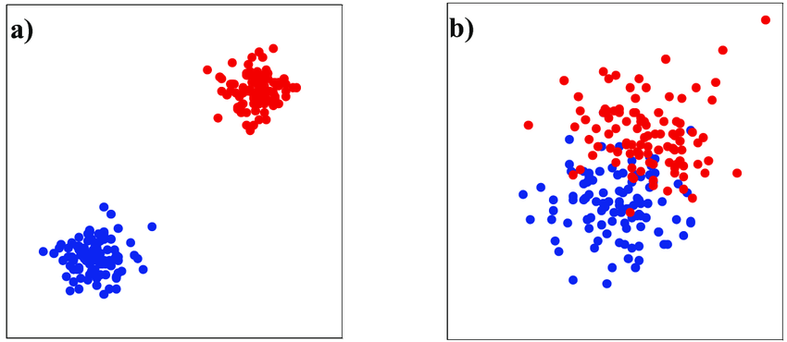
Feature selection
ANOVA
If the between-group variance is significantly larger than the within-group variance, it suggests that there are significant differences between the group means, and we reject the null hypothesis.
Canuto, J. C. (2014). Biomechanical online signature modeling applied to verification (Doctoral dissertation, Institut National des Télécommunications).

Slide 30
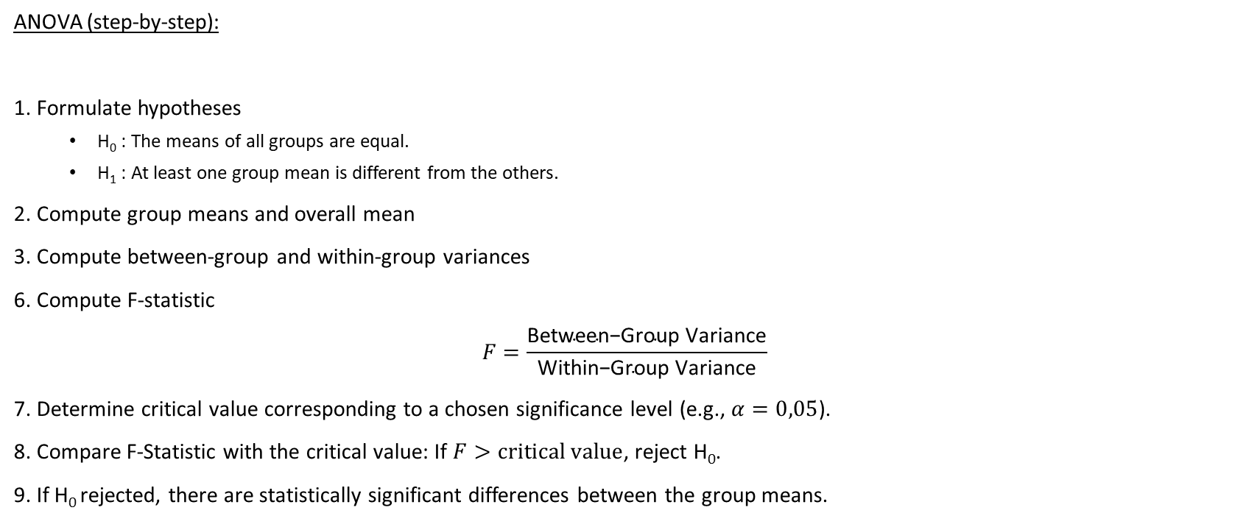
Feature selection
ANOVA (step-by-step):
1. Formulate hypotheses
H₀ : The means of all groups are equal.
H₁ : At least one group mean is different from the others.
2. Compute group means and overall mean
3. Compute between-group and within-group variances
6. Compute F-statistic
$$F=\frac{\text{Between}\text{−}\text{Group} \text{Variance}}{\text{Within}\text{−}\text{Group} \text{Variance}}$$
7. Determine critical value corresponding to a chosen significance level (e.g., $α=0,05$).
8. Compare F-Statistic with the critical value: If $F>\text{critical} \text{value}$, reject H₀.
9. If H₀ rejected, there are statistically significant differences between the group means.

Slide 31
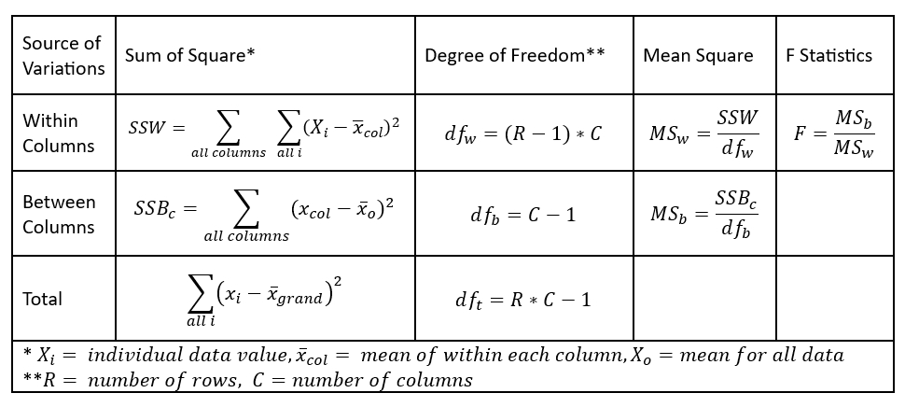
Feature selection
By Luyan Li - Own work, CC BY 4.0, https://commons.wikimedia.org/w/index.php?curid=140549619

Slide 32
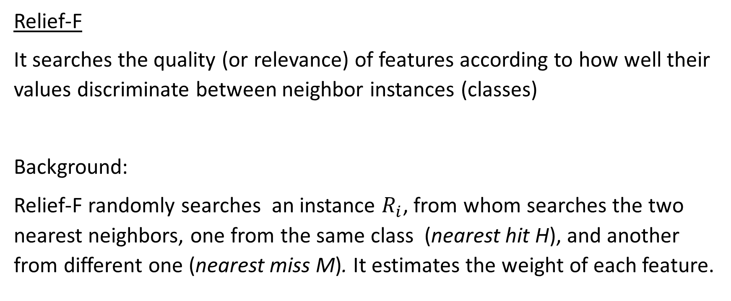
Feature selection
Relief-F
It searches the quality (or relevance) of features according to how well their values discriminate between neighbor instances (classes)
Background:
Relief-F randomly searches an instance $R_{i}$, from whom searches the two nearest neighbors, one from the same class (nearest hit H), and another from different one (nearest miss M). It estimates the weight of each feature.

Slide 33
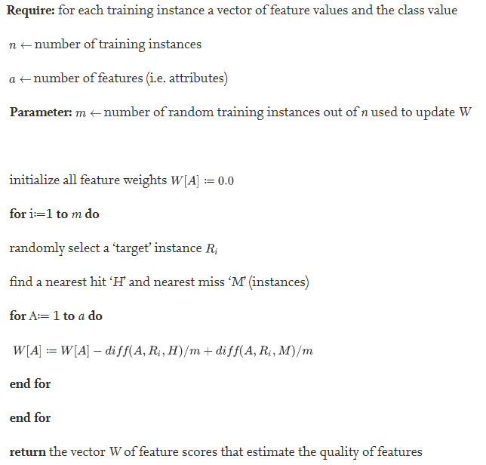
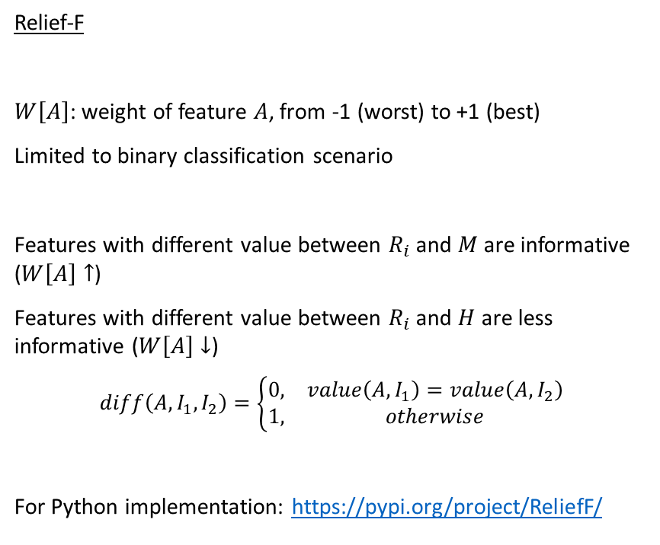
Feature selection
Relief-F
$W\left[A\right]$: weight of feature $A$, from -1 (worst) to +1 (best)
Limited to binary classification scenario
Features with different value between $R_{i}$ and $M$ are informative ($W\left[A\right]↑$)
Features with different value between $R_{i}$ and $H$ are less informative ($W\left[A\right]↓$)
$$diff\left(A,I_{1},I_{2}\right)=\left\{\begin{matrix}0, & value\left(A,I_{1}\right)=value\left(A,I_{2}\right) \\ 1, & otherwise\end{matrix}\right.$$
For Python implementation: https://pypi.org/project/ReliefF/
Urbanowicz, R. J., Meeker, M., La Cava, W., Olson, R. S., & Moore, J. H. (2018). Relief-based feature selection: Introduction and review. Journal of biomedical informatics, 85, 189-203.

Slide 34
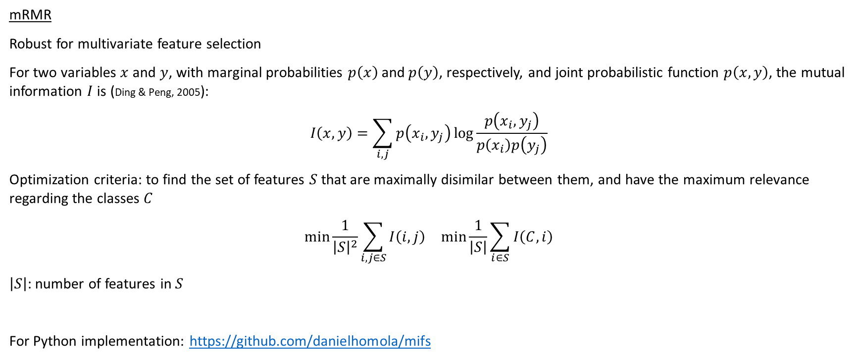
Feature selection
mRMR
Robust for multivariate feature selection
For two variables $x$ and $y$, with marginal probabilities $p\left(x\right)$ and $p\left(y\right)$, respectively, and joint probabilistic function $p\left(x,y\right)$, the mutual information $I$ is (Ding & Peng, 2005):
$$I\left(x,y\right)=\sum_{i,j}{p\left(x_{i},y_{j}\right)\log{\frac{p\left(x_{i},y_{j}\right)}{p\left(x_{i}\right)p\left(y_{j}\right)}}}$$
Optimization criteria: to find the set of features $S$ that are maximally disimilar between them, and have the maximum relevance regarding the classes $C$
$$\begin{matrix}\min{\frac{1}{{\left|S\right|}^{2}}\sum_{i,j∈S}{I\left(i,j\right)}} & \min{\frac{1}{\left|S\right|}\sum_{i∈S}{I\left(C,i\right)}}\end{matrix}$$
$\left|S\right|$: number of features in $S$
For Python implementation: https://github.com/danielhomola/mifs

Slide 35
Hints for Feature Selection
Do you have a background knowledge about the problem?
Build an ad-hoc feature set
Do you need to evaluate the features individually?
Choose ranking methods
Do you think your data have noise?
Search for outliers

Slide 36
Recommended links
Relief algorithm in Deep: https://www.sciencedirect.com/science/article/pii/S1532046418301400
A review of feature selection methods: https://link.springer.com/content/pdf/10.1007/s10115-012-0487-8.pdf
AUC-ROC from scratch in Python: https://github.com/akshaykapoor347/Compute-AUC-ROC-from-scratch-python

